Slide 1
New Project
Brandon Moe

Slide 2
Todays Lesson
Making your First Project

Slide 3
Making a Project

Slide 4
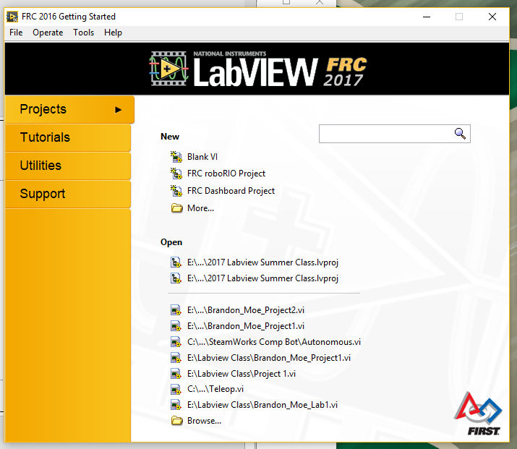
Open Labview
Click file -> new

Slide 5
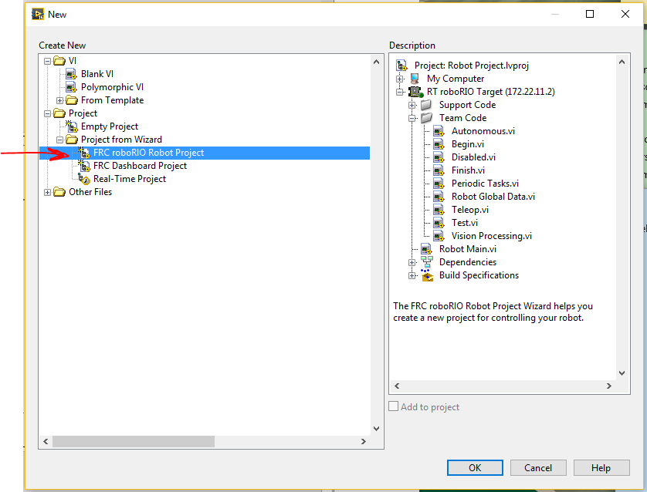

Slide 6
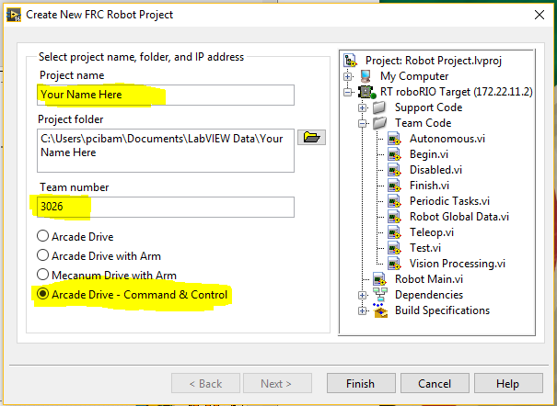
First_Last should be project name.
Make the project folder somewhere you can find it

Slide 7
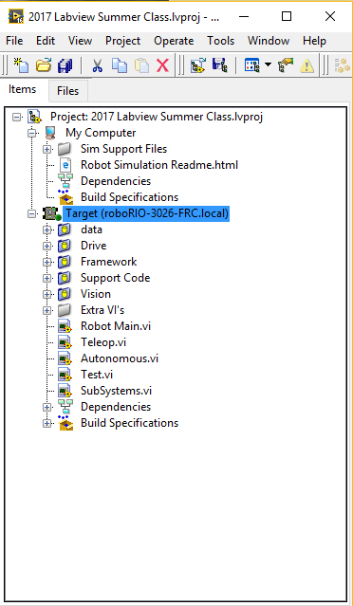
Right Click on Target
Click new -> new virtual folder
Name it Extra VI’s

Slide 8
Programing Basics
https://firstinmaryland.org/images/stories/documents2015/2015_FRC_Education_Day/2015_BAAFallEducation_LabVIEW.pdf

